Slide 1
5G Testbed L2 Protocol Stack

Slide 2
Contents
Introduction to team
Quick Overview
Present status of the L2 stack
Future workflow of the protocol stack

Slide 3
Team
Jitesh
Monisha
Shakti
Tejaram
Nitin
New Interns
  2 - 4th Year Students (EE-2)
  3 - 3rd Year Students (EE-3)
  6 - 2nd Year Students (EE-3 CSE-3)
  5 - 1st Year Students (EE-3 CSE-2)

Slide 4
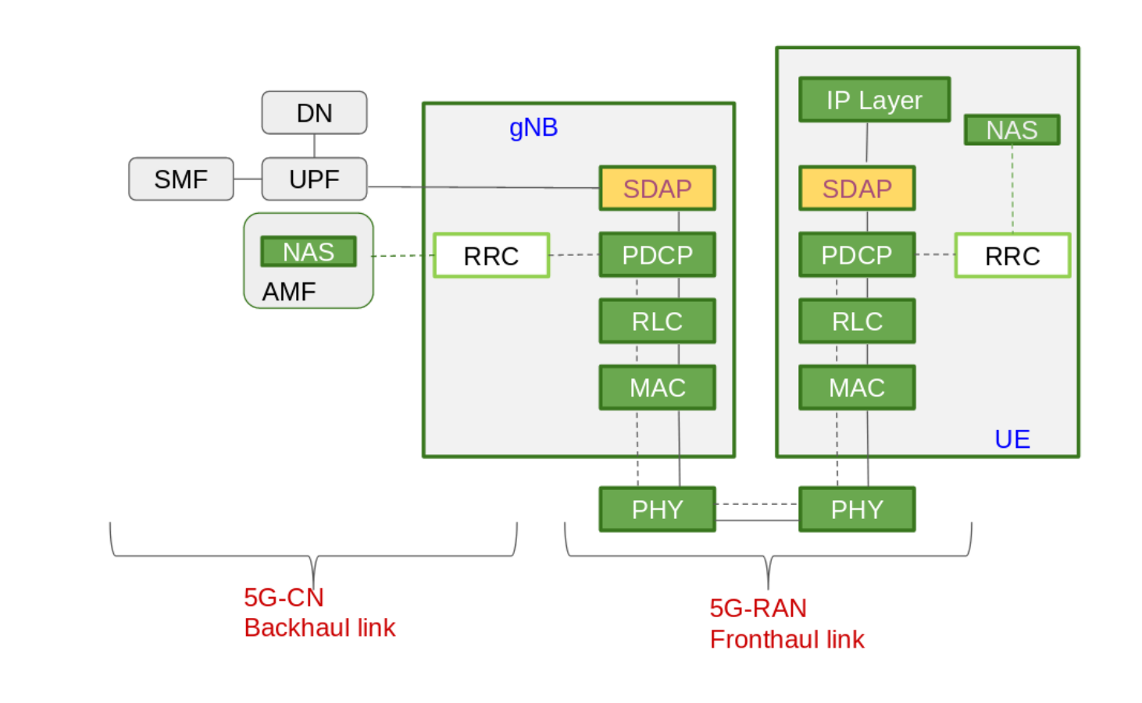
Overview

Slide 5
Present Status of L2 Stack

Slide 6
User Plane Data Flow
Traffic Generation
Data Generation
Benchmarking
Configuration, Status and Control messages
Buffer
SDAP Header addition
Default QoS to DRB mapping
SDAP
Sequence Numbering
Header Compression/Decompression
    ROHC algorithm
Integrity protection/check
Ciphering/Deciphering
In-order packet delivery to higher layer
Buffer
L2 Controller
PDCP
Segmentaion/Reassmebly (UM mode)
Sequence Numbering for Segmented packet
Buffer
RLC
Multiplexing/Demultiplexing
MAC Header addition/extraction
Buffer
MAC

Slide 7
Issues Being faced
Memory Leaks
Malformed IP packet detection at PDCP layer
An unknown issue present with all sublayers integrated when running for longer duration. (under Debugging mode)

Slide 8
Shortcomings
The sub layers implement the functionality as per the spec but as a whole integrated system the stack is just a pipe for transmission of data.
Major Memory leaks

Slide 9
Upcoming Work

Slide 10
User Plane Data Flow
Traffic Generation
Data Generation
Benchmarking
Configuration, Status and Control messages
Buffer
QoS to DRB mapping rule
Interface with UPF
Have interns familiarized
SDAP
Code review and optimization
Have interns familiarized
Buffer
L2 Controller
PDCP
UM Mode
  Segmentation of SDU for 12-bit SN field
  Reassmebly via t-reordering
All functionalities of AM mode
All functionalities of AM mode
Buffer
RLC
Design MAC Architecture
Buffer
MAC

Slide 11
Bring up of RRC module
Bring up of L2/L3 interface with Corenetwork
Makefiles
Documentation
  Code
  Coding style
  Sublayer functionalities

Slide 12
Future Workflow
Overall L2/L3 Architecture design docuemnt
Implementation Architecture design of overall L2/L3 document
Individual sublayer abstract architecture design
Individual sublayer implementation architecture design
Configuration messages flow for each sublayer
Message passing flowcharts

Slide 13
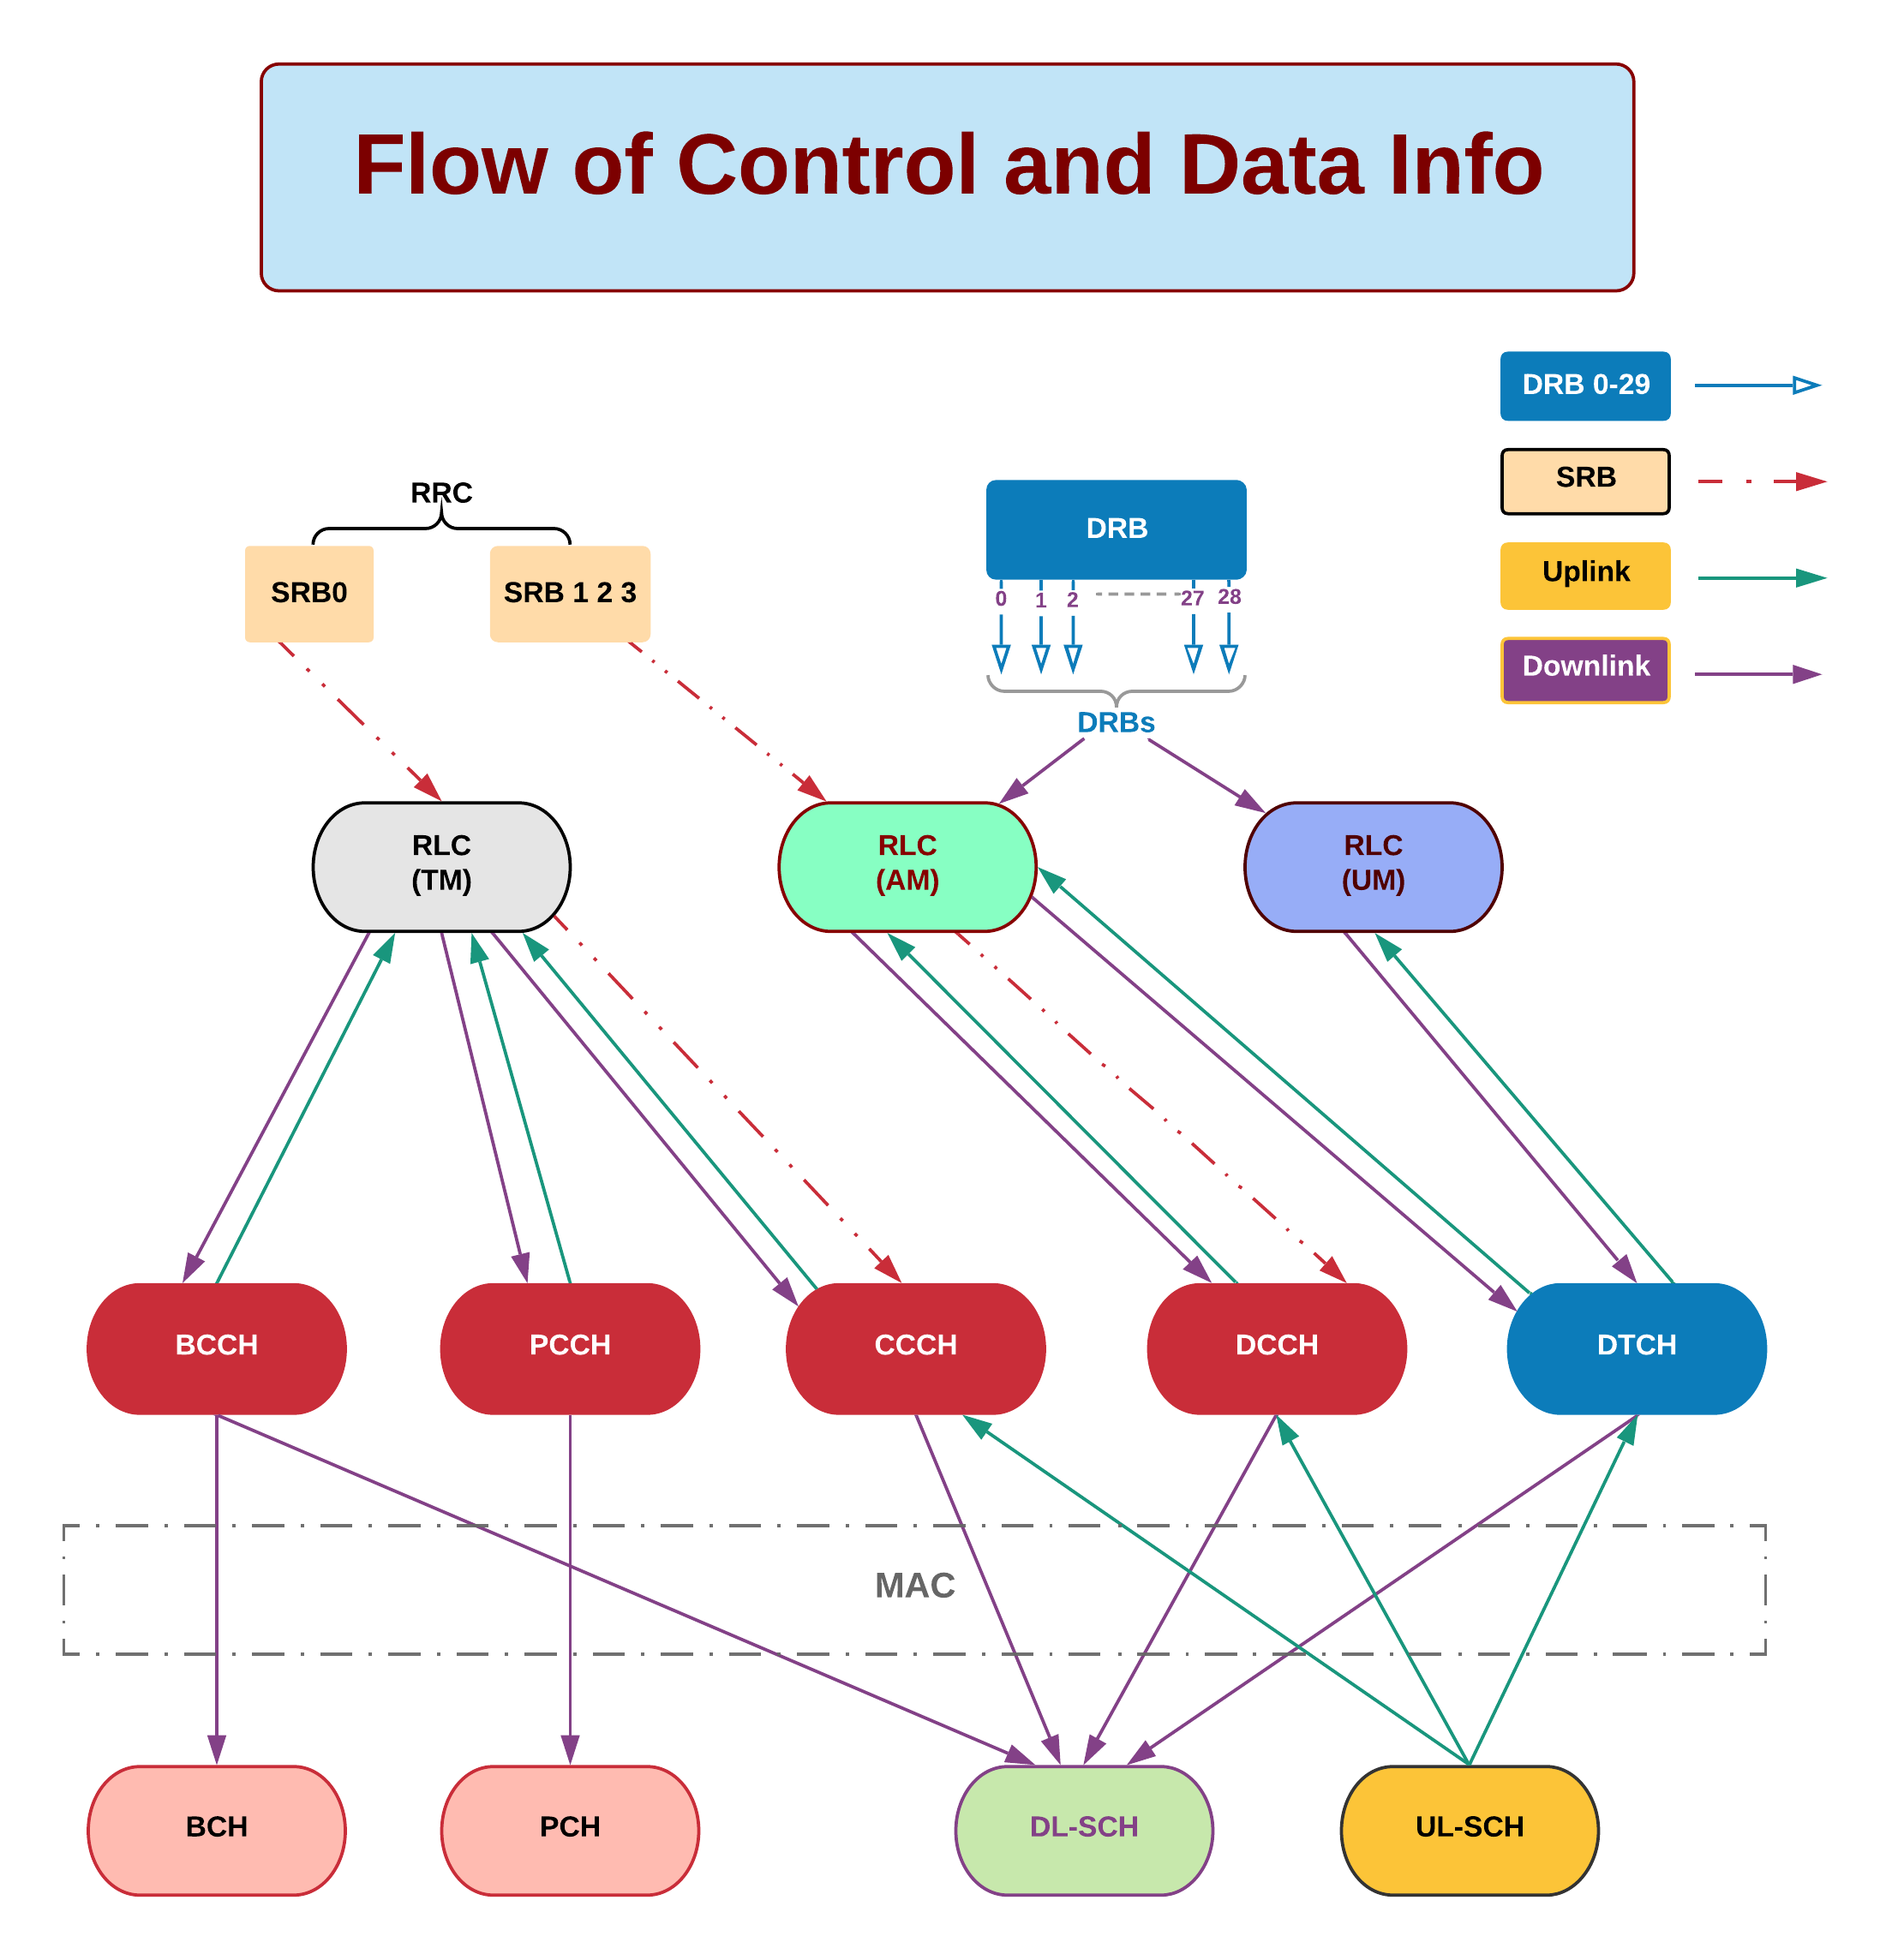

Slide 14
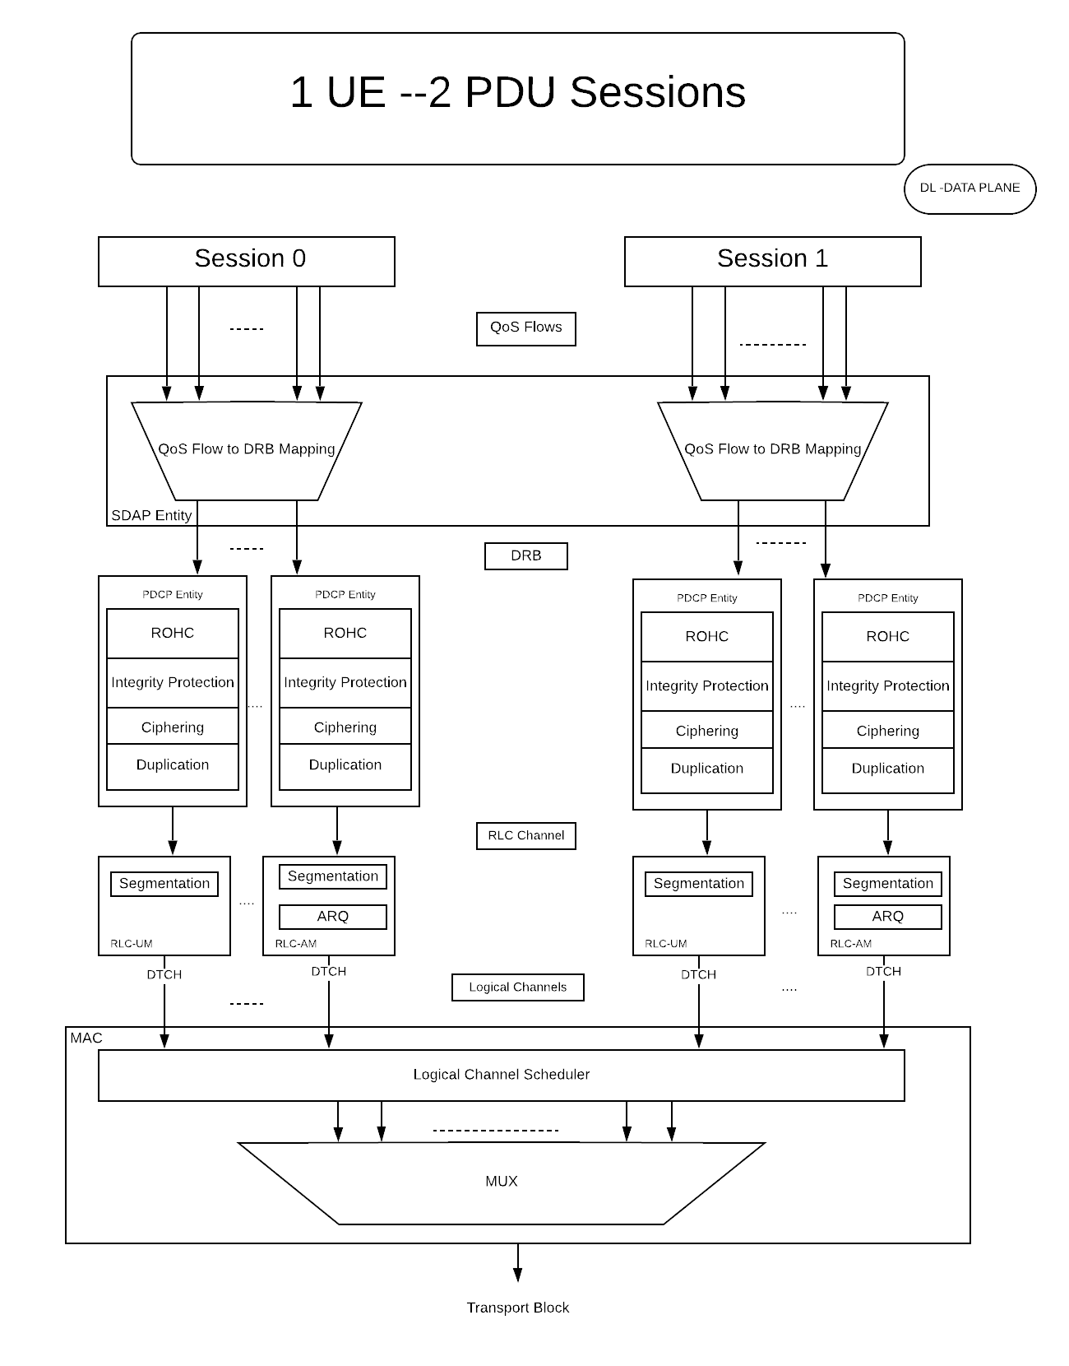

Slide 15
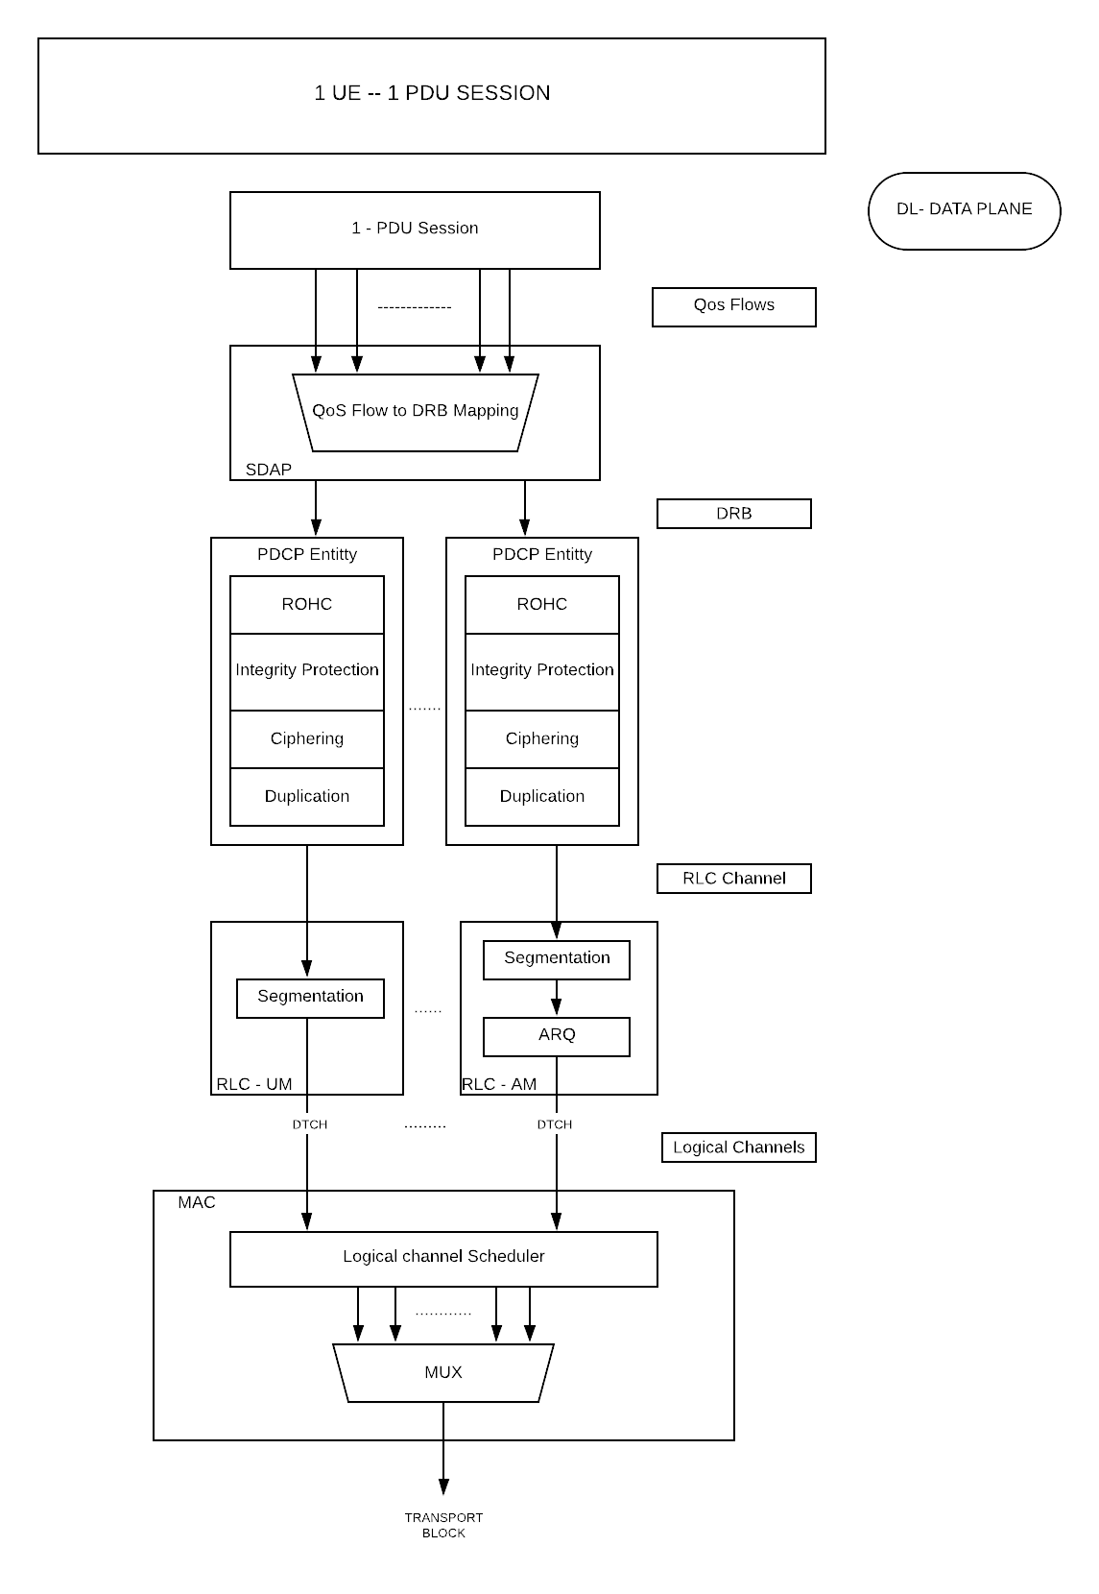

Slide 16
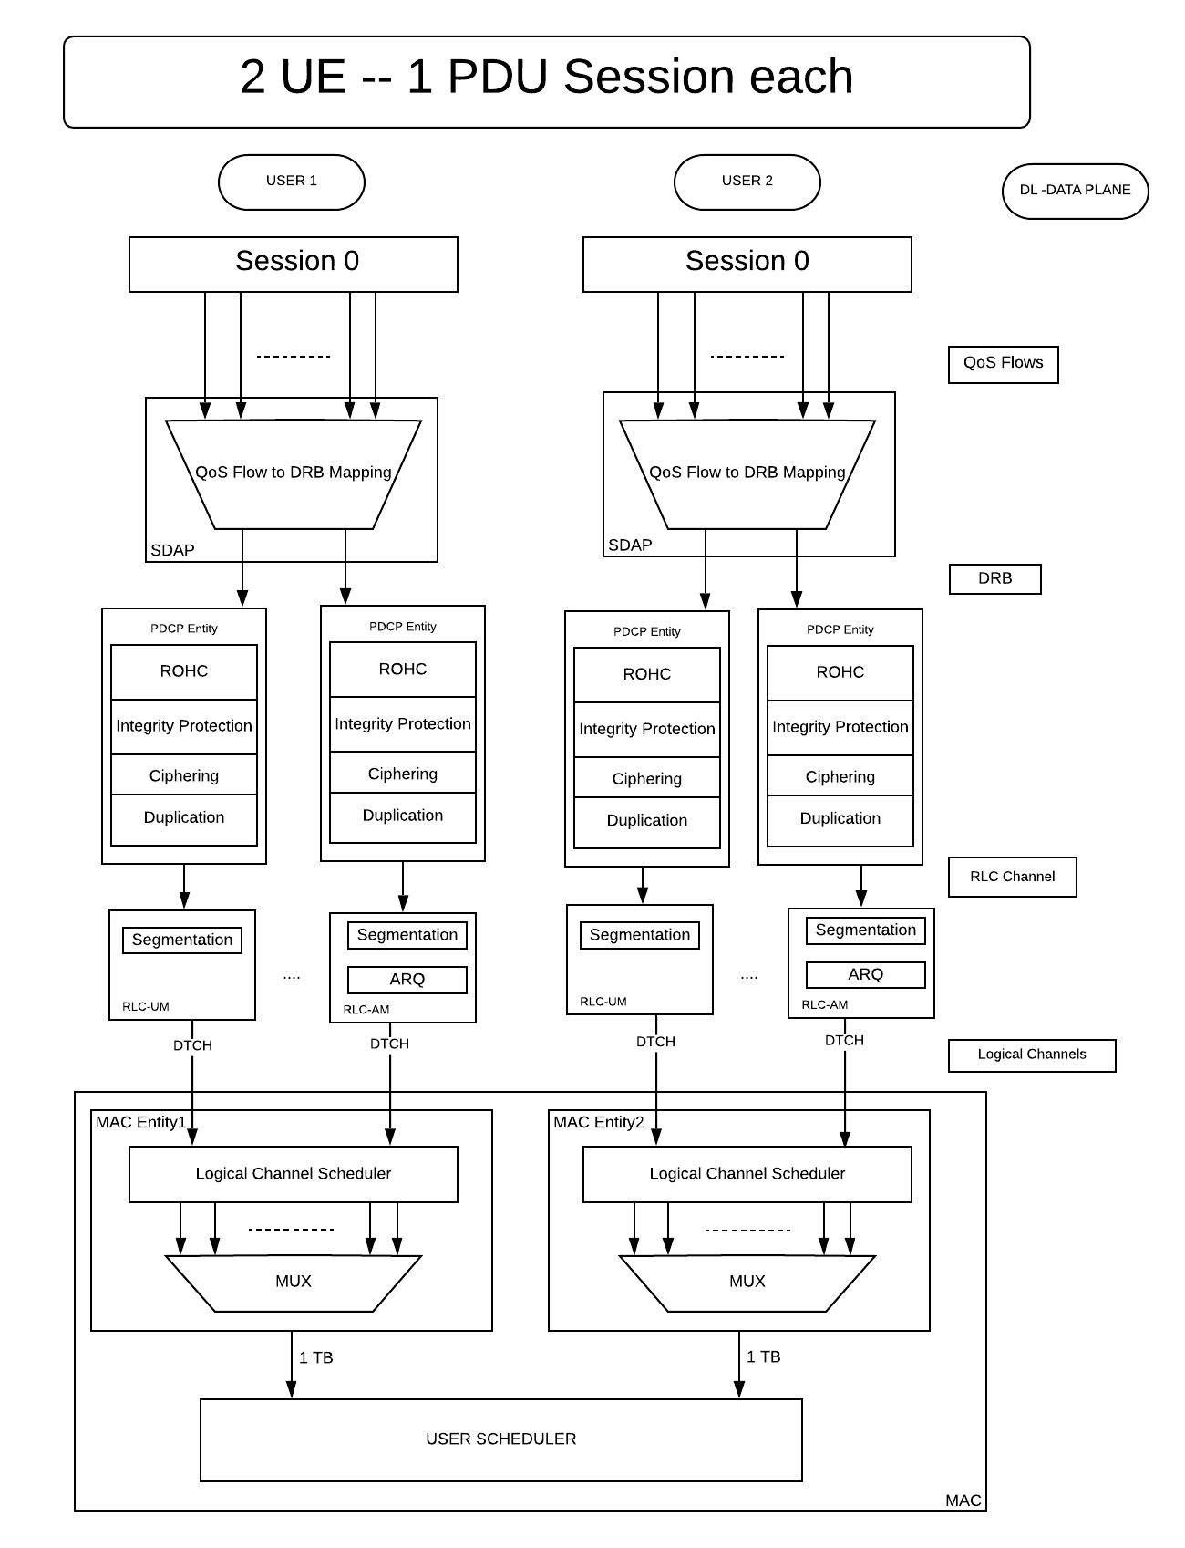

Slide 17
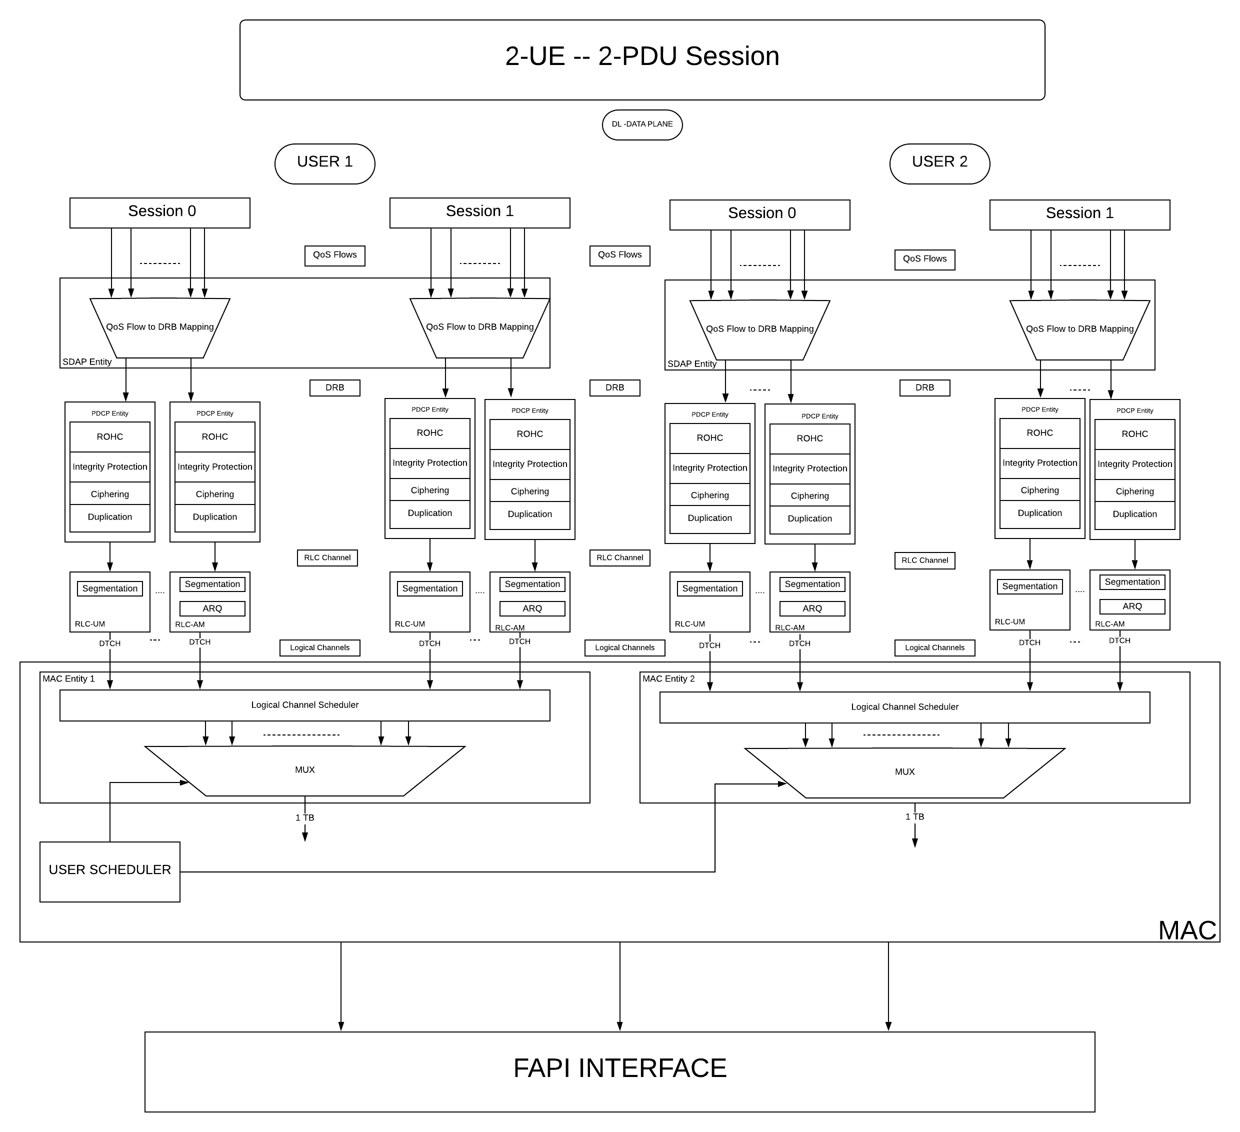

Slide 18
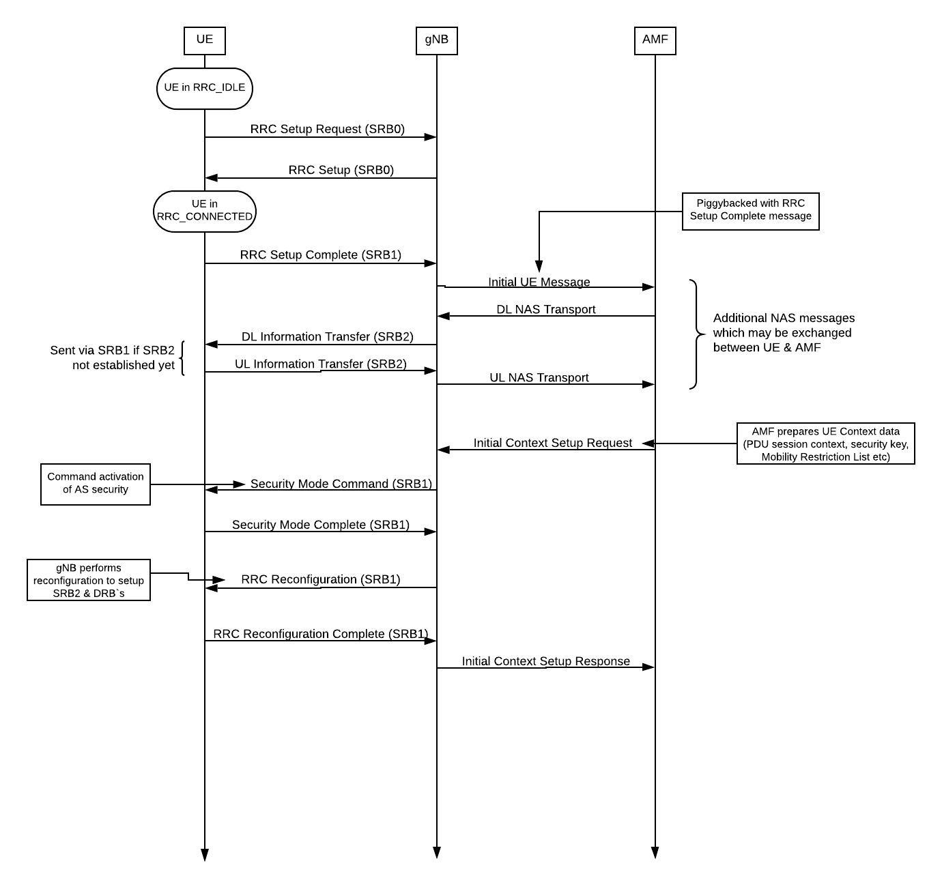
RRC_IDLE to INITIAL_CONTEXT_SETUP

Slide 19
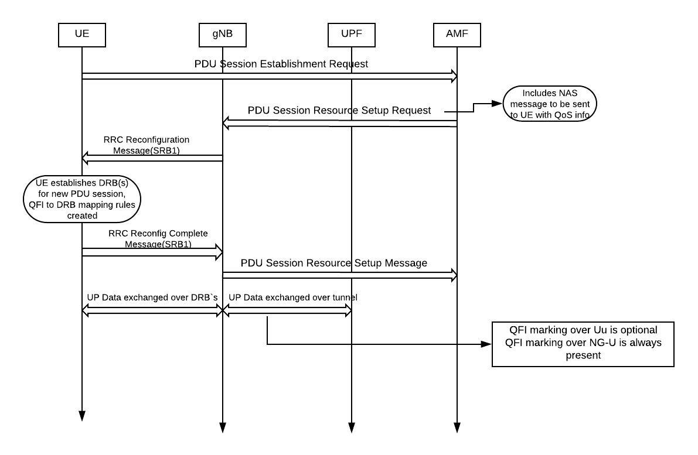
PDU Session Establishment

Slide 20
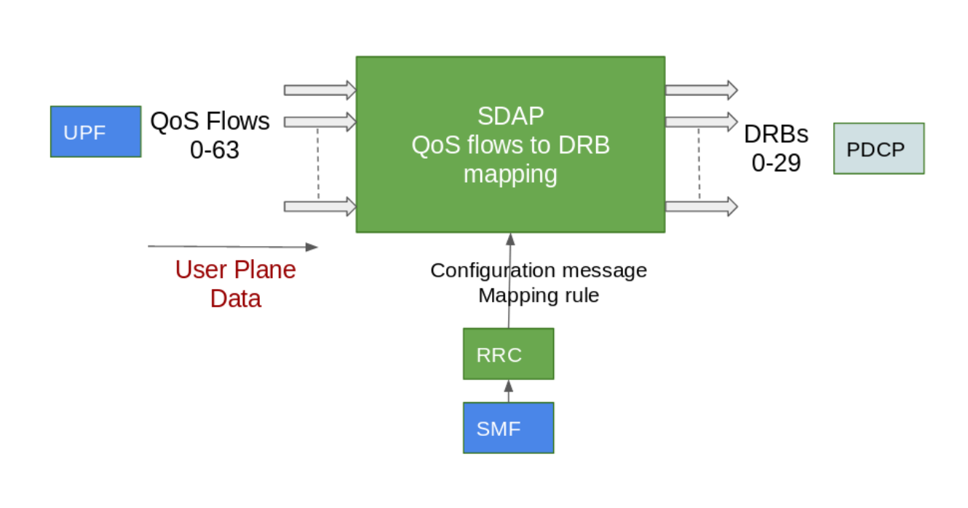
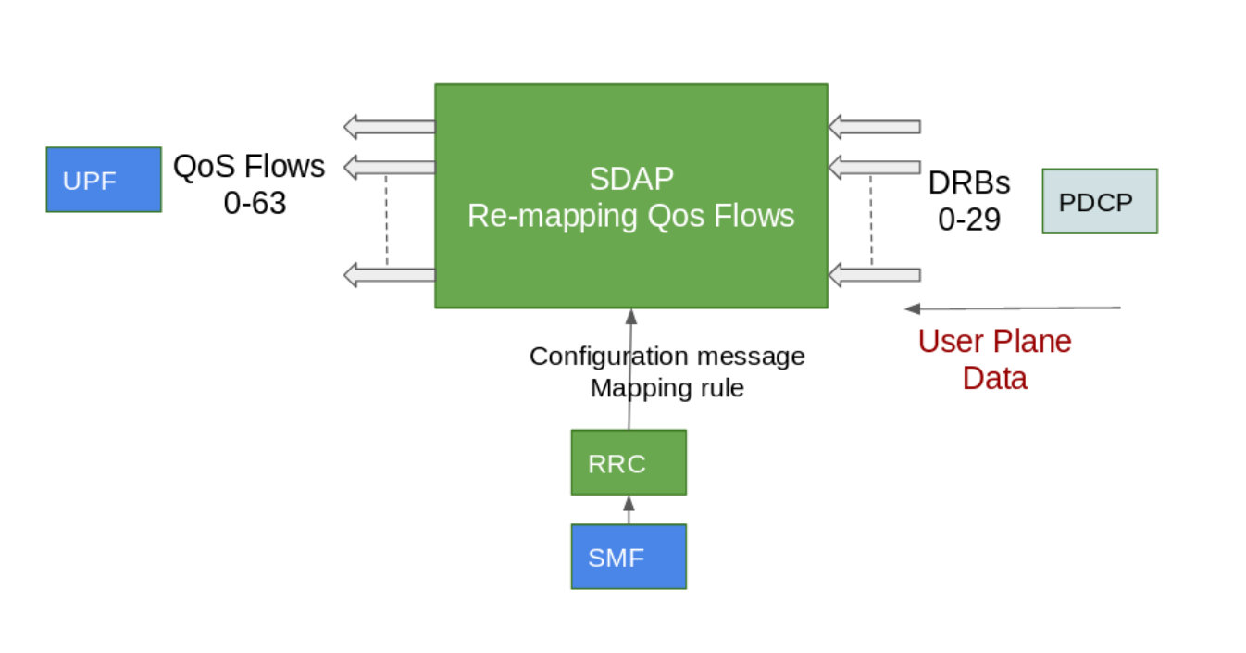
SDAP

Slide 21
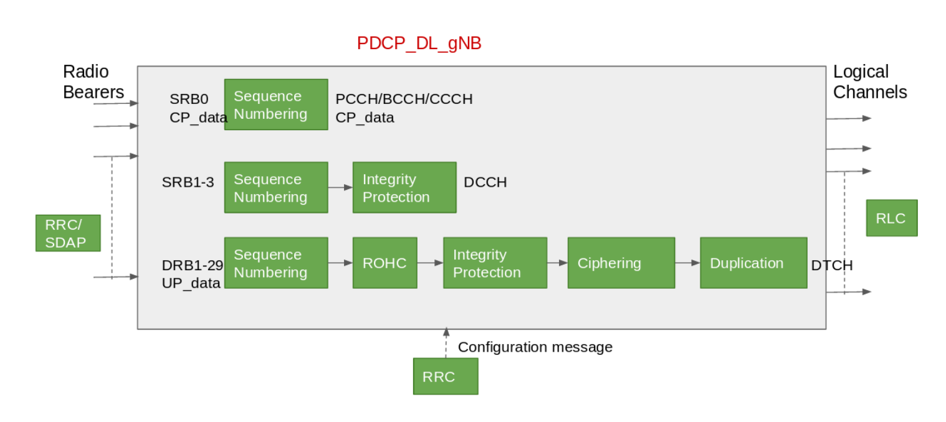
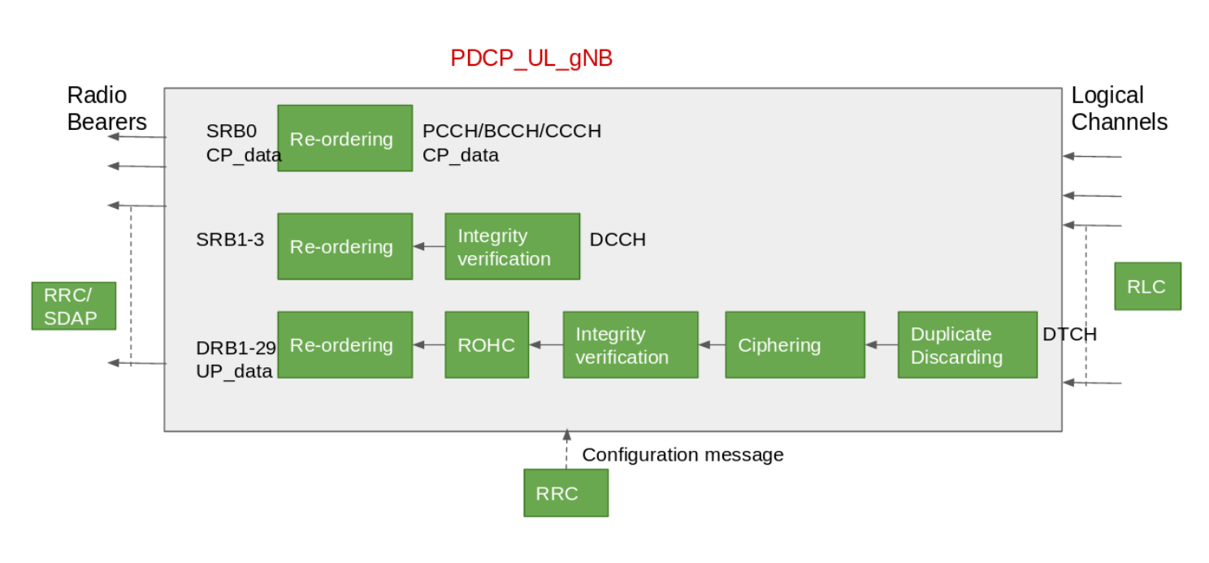
PDCP

Slide 22
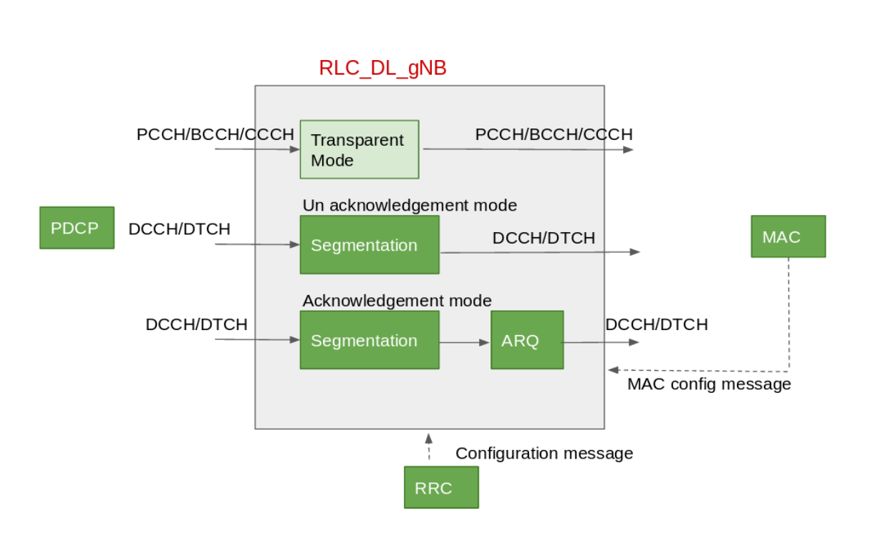
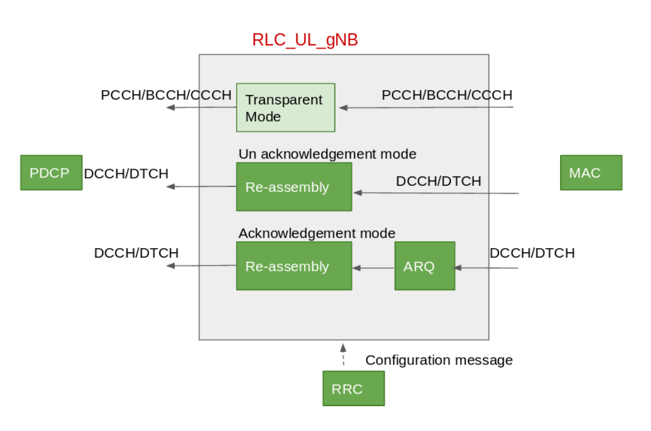
RLC

Slide 23
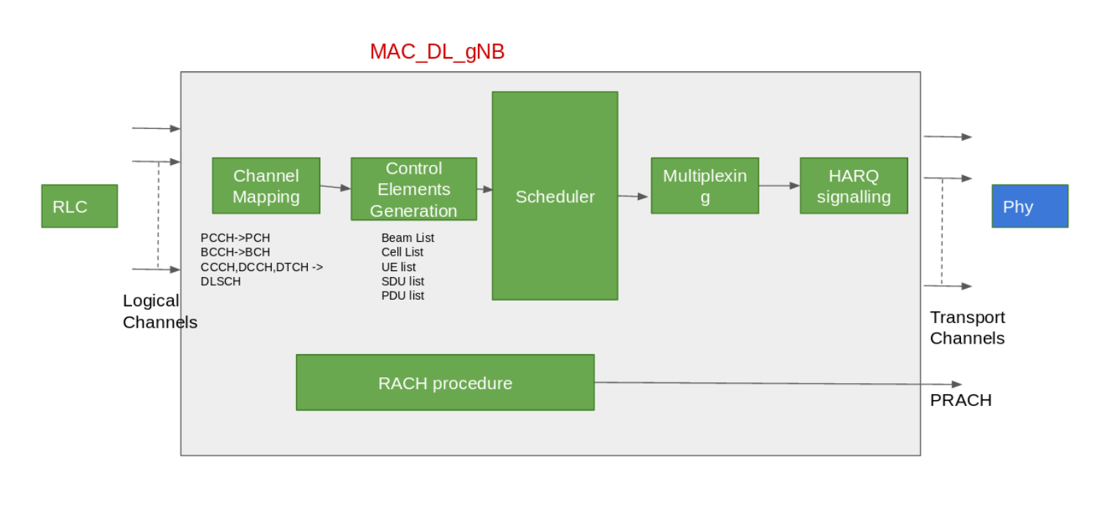
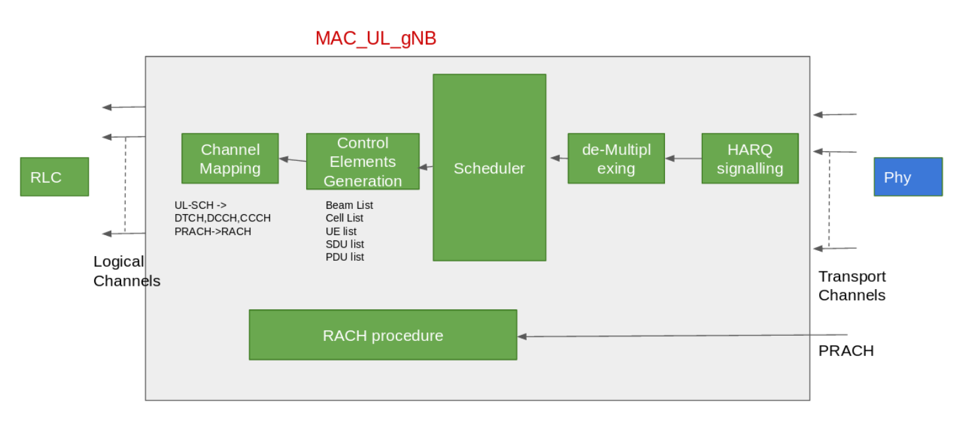
MAC

Slide 24
Message calls Details

Slide 25
Thank You

